Slide 1
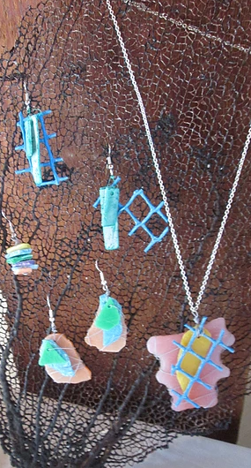
Analytics on the Movement of Floating Marine Debris
A Presentation by Visual Pearl Group.

Slide 2

Crew Members
Olashile Adebimpe(B00761325)
Salil Vishnu Kapur(B00781529)
Nishanth Antony(B00755270)
Utku Gultopu(B00772012)
Notes:
We will be showing a brief Video just bring your attention to the topic of discussion, the issue at hand and what our solution is driving at.

Slide 3
Presentation Outline
Introduction
Motivation
Data Definition, Description and Preprocessing
Solution Architecture and Framework
Live Demo of the Proposed System
Conclusion and Future Works

Slide 4


Slide 5
Outline
Introduction
Motivation
Data Definition, Description and Preprocessing
Solution Architecture and Framework
Live Demo of the Proposed System
Conclusion and Future Works

Slide 6

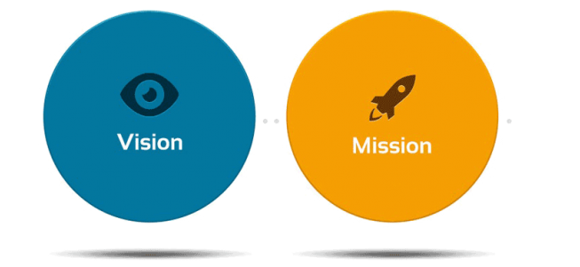
Introduction
This project is a collaborative initiative with the Bahamas Plastic Movement.
Bahamas Plastic Movement mission is to build a community of education and activism around plastic pollution.
They envision a world where an engaged public has created a nation free of plastic debris.
Notes:
Bahamas Plastic Movement believes that through research, education, citizen science & policy change, we can create a healthy marine and terrestrial environment free of plastic pollution.
So we are trying to create some Visual representation for their research

Slide 7

Project Introduction
Our project dealt with the biggest issue of Debris all over the world.
Classification and Prediction of debris per continent in 2018 and 2019.
Marine Debris Tracker Mobile app and Bahamas Plastic data are our primary data source.
Notes:
Investigating marine debris concentration on our beaches.

Slide 8
Outline
Introduction
Motivation
Data Definition, Description and Preprocessing
Solution Architecture and Framework
Live Demo of the Proposed System
Conclusion and Future Works

Slide 9

Motivation
To analyze and visualize the debris data around the world, and in specific locations, in order to make inferences about the movement and accumulation of debris.
Notes:
Visualise , analyse, and provide meaniful insight about debris data arounb the world and in specific locations so as to make inference about the movement and accumulation of debris da

Slide 10
Outline
Introduction
Motivation
Data Definition, Description and Preprocessing
Solution Architecture and Framework
Live Demo of the proposed system
Conclusion and Future Works

Slide 11

Data Definition
We got over 200,000 records of data in multiple segment from different community.
The data contains geographical features of debris from different communities.

Slide 12
Data Definition

Slide 13
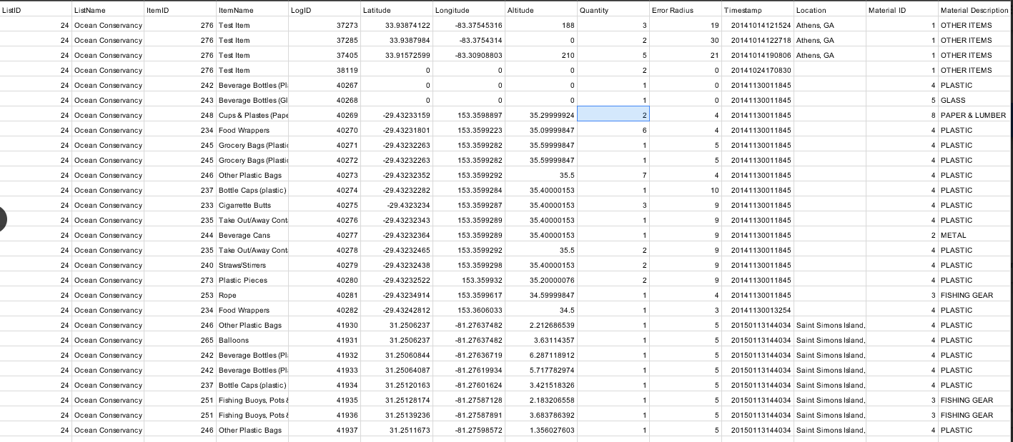
Data Snapshot

Slide 14


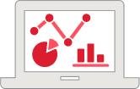

Data Preprocessing
Data Collection & Storage
Data Cleaning & Preprocessing
Data Analysis & Mining
Data Visualization & Exhibition
Python
Panda Libraries
Python
Panda Libraries
Prediction
Classification
Transformation
D3
JQuery
Bootstrap
Azure Web service
Notes:
Data Collection and storage:
Python Panda and Numpy libraries
Data Cleaning & Preprocessing:
sklearn.preprocessing, Distribution of the data, standardization, Null removal, Outliers treatment
Data Analysis & Mining:
Data mining encompasses a number of predictive modeling techniques
Linear Regression and Outlier analysis(Examine Outliers to examining potential causes and reason for the said outliers)

Slide 15
Outline
Introduction
Motivation
Data Definition, Description and Preprocessing
Solution Architecture and Framework
Live Demo of the proposed system
Conclusion and Future Works

Slide 16


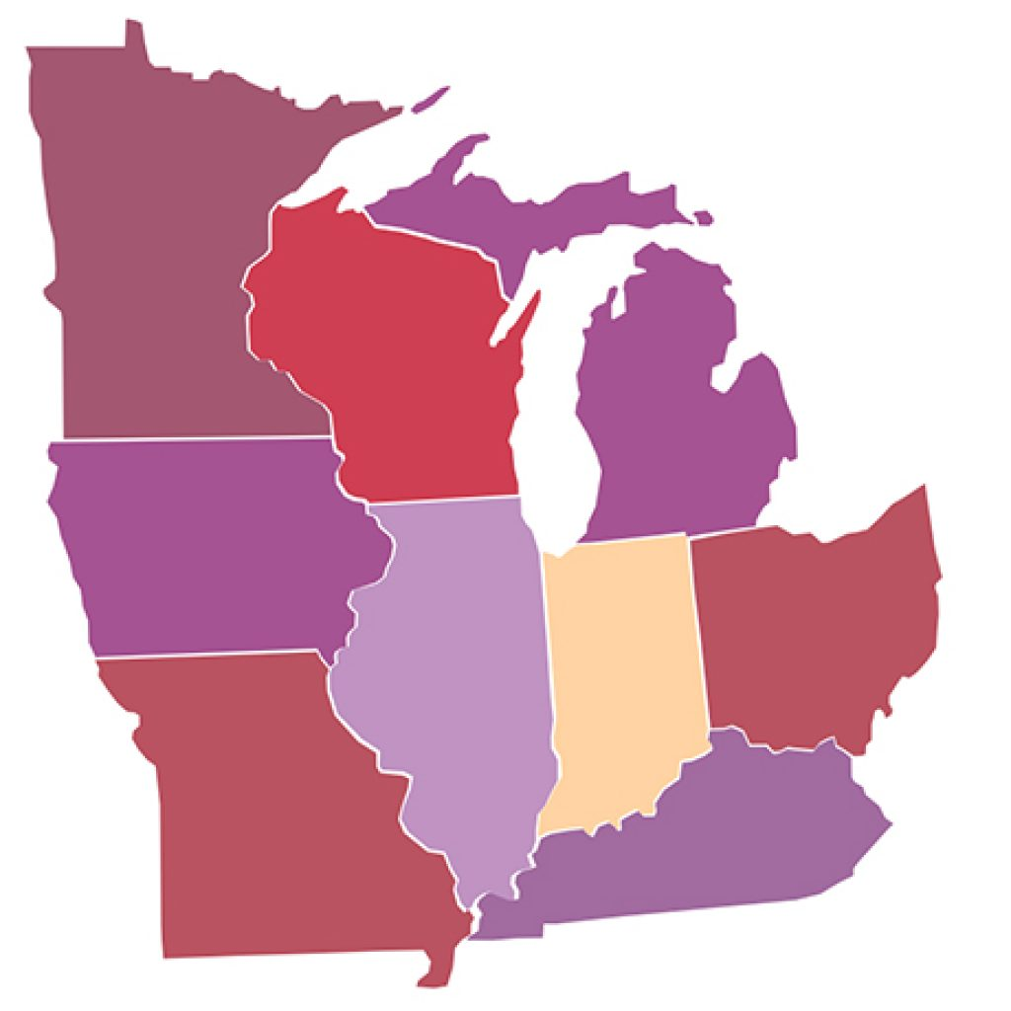



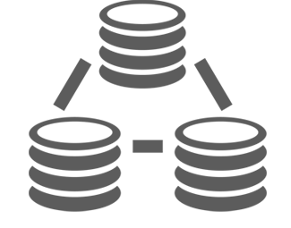





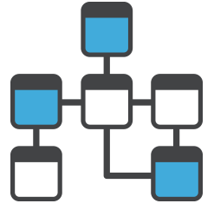


Solution Architecture and Framework
Data Preprocessing
Data
Visualization
Data
Cleaning
Data
Integration
Data
Transformation
Data
Aggregation
Data
Exploration
Data
Mining
Predictive Web Service
Web Service Input
Trained Poisson Regression
Web Service Output
Request
Response
Notes:
Data Cleaning and merging, knowing the right data to pick from all forms of data available for the project
Data Aggregation, ensuring with Python Panda libraries that that to be merge together are of the same form are consistent with the other forms of data.
Data Exploration using Matplotlib, Stats models , numpy and panda to give a first hand visualization(with pie chart and bar chart) about our data and the distribution of the data so we can make sense of it.
Data Transformation was in two folds, transforming data for each level of visualization and also transforming data for our future predictions. Dataset transformations, Normalizing, and scaling the data for the training model.
Data Mining: association, classification, clustering, prediction, sequential patterns and decision tree.
We only employed Classification and prediction in python SKLEARN ALGORITHM for our models and predictions.
Visualization: all Visualization was done with D3 in addition with to jQuery, JavaScript and Bootstrap

Slide 17
Outline
Introduction
Motivation
Data Definition, Description and Preprocessing
Solution Architecture and Framework
Live Demo of the proposed system
Conclusion and Future Works

Slide 18
Outline
Introduction
Motivation
Data Definition, Description and Preprocessing
Solution Architecture and Framework
Live Demo of the proposed system
Conclusion and Future Works

Slide 19

Conclusion
Our purpose was to help the community understand how terribly the debris is hitting the world and how we can reduce it's impact on us.
And we have provided visual insight on how much clean up should happen in the future and how and the rate of clean up happening presently.

Slide 20

Future Works
Add an API for uploading new data and downloading existing data
Add our Visual Analytics Module into the existing marine debris tracker Mobile app

Slide 21

Questions
Questions

Slide 22
End

Slide 23
Reference
https://www.youtube.com/watch?v=-OyEcLuDMek
https://www.iconfinder.com

